Slide 1
Model to Predict Induction into the Baseball Hall of Fame
Brian Hallberg
July 3, 2018

Slide 2
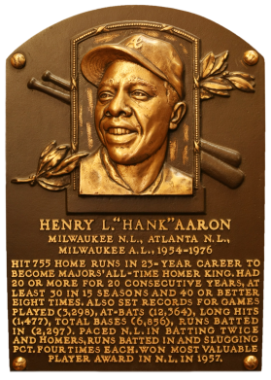
Introduction
Election to the Baseball Hall of Fame is the highest honor bestowed on any player.
- Made significant contribution to baseball
- Legendary Player
- Played at least 10 years in the major league
- Retired for at least 5 years
- Inducted within 10 years of retirement

Slide 3
The Data
This project makes use of a data set called the History of Baseball
Covering the period from 1871 to 2015
All-Star Game and Hall of Fame selections
Yearly statistics on over 18,000 players
Following tables used:
Player
All Star
Hall of Fame
Pitching
Batting
Data available from Kaggle Repository
http://www.kaggle.com/seanlahman/the-history-of-baseball

Slide 4
Data Wrangling
Import Data Sets
Explore Structure
Delete Unused Columns and Rows
Change Column Names
Merge Multiple Tables Together
Split Table into pitcher and Nonpitcher
Create new columns for further analysis
Create Table of Eligible Players

Slide 5
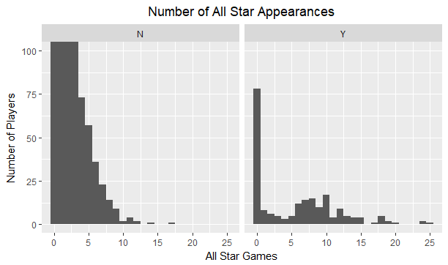
Is all Star Appearance Enough?
Y are inducted in the Hall of Fame
More game appearances may be an indicator but it does not appear to be a guarantee
Some hall of fame players did not play in even one game so it is not required either.

Slide 6
Preliminary Exploration
Data Set of players include 18,846 individuals
From that group, there are 2385 with data and eligible for the Hall of Fame
From that group, there are 211 identified as being in the Hall of Fame
So as a baseline 9% of those eligible have been inducted

Slide 7
Developing the Model
The dependent variable Induction is a binary event (either in the hall of fame or not)
This directed a Logistic Regression for the model
After working a number of possible predictors the best model uses
All Star Appearances
Career Home Runs
Career Runs Batted In
Career Runs Scored
Career Batting Average
Career Wins for Pitcher
Career Earned Runs allowed

Slide 8
The Model Performance
Using just All Star Appearances and all players
Accuracy – 92%
Only predicted 15% of actual hall of fame players
Using all players and all predictor variables
Accuracy – 92%
Predicted 16% of actual hall of fame players
Split of just Non Pitchers
Accuracy – 94%
Predicted 44% of actual hall of fame non pitchers
Split of just Pitchers
Accuracy – 97%
Predicted 75% of actual hall of fame pitchers

Slide 9
The Model Performance on New data
Using data from the initial players another table was built from those players not currently eligible for the hall of fame.
Still active players
Not elected yet, but still within 10 years of retirement so eligible
By model those identified as future hall of fame inductees
* Indicate already elected since 2015
Pitchers
Roger Clemens
Tom Glavine
Roy Halladay
Randy Johnson
Greg Maddux
Pedro Martinez
Mike Mussina
Andy Pettitte
CC Sabathia
John Smoltz
Non Pitchers
Barry Bonds
Miguel Cabrera
Ken Griffey*
Vladimir Guerrero*
Derek Jeter
Chipper Jones*
Bobby Korecky
Mike Piazza*
Albert Pujols
Manny Ramirez
Alex Rodriguez
Ivan Rodriguez*
Gary Sheffield
Ichiro Suzuki
Josh Tomlin

Slide 10
Conclusions
All-Star Game appearances alone is not a good predictor of Hall of Fame induction, but it is important to include with other indicators.
It is better to have one model for the pitchers and another for the non pitchers to be most effective.
It appears that many of the indicator statistics in the tables are correlated and makes the model more difficult to build.
The model for pitcher is more accurate at predicting hall of fame pitchers than the non pitcher model is at predicting hall of fame non pitchers.
Both models are better at predicting players that will not be inducted into the hall of fame.

Slide 11
Recommendations
There is a data file with fielding statistics and its inclusion may help the model
Another factor that may impact the prediction, is time. It may be that the players should be looked at by decade or some other unit of time. Players within the time, may be predictable, but not between the blocks of time.
Finally, it may also be worth looking at this from the standpoint of who should be on the ballot as a possible Hall of Fame player. This model would be based on statistics and should keep top quality players on the ballot. The voting may be based on data not in this data set.

